Slide 1

Prisma Access POC Discussion

Slide 2
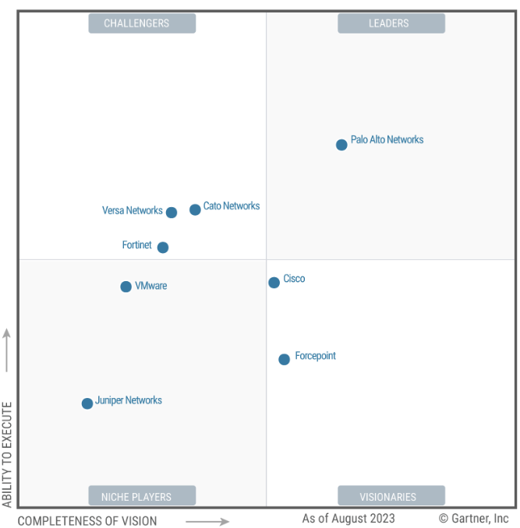
Gartner Report 2023

Slide 3
POC參與操作人員
公司 | 職務 | 人員 | Email
Customer | 承辦人 | Allen Su | Allen.Su@BenQ.com
Customer | 承辦人 | Ivan.HW.Lin | Ivan.HW.Lin@Qisda.com
SI | SE | Jun Chung | junc@hauman.com.tw
SI | SE | Michael Jian | michaelj@hauman.com.tw
PANW | SE | Ricky Wang | riwang@paloaltonetworks.com
Disti | Engineer | Rex Huang | rex.huang@westcon.com

Slide 4






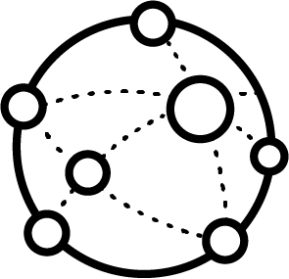
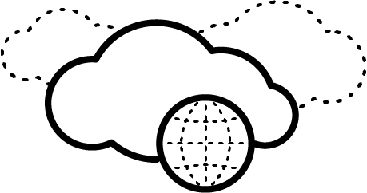
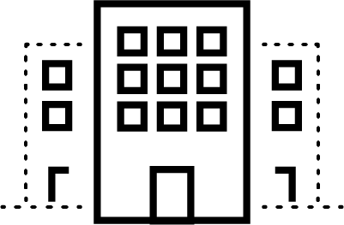
POC Diagram
Azure Active Directory
Encrypted Tunnel
SAML
SaaS
US PoP
Encrypted Tunnel
Prisma Access
行動使用者
安裝GP Agent
TW PoP
Internet
Public Cloud
Service Connection
Service Connection
Encrypted Tunnel
FW Gateway IP?
Encrypted Tunnel
Encrypted Tunnel
FW
FW
Public Cloud
App
FW
App
DNS
HQ
branch

Slide 5
收集客戶資訊 Core Networking
Infrastructure Subnet | Prisma Access 服務所使用，最小需要 /24 網段 | 10.73.38.0/23
Mobile User Subnet (=>/22) | GP User 連上 Prisma Access 後取得的 IP 網段，最小需要 /22 網段 | 10.73.56.0/22
Data Center Subnets | Data Center / Server Farm 網段 | TP(SC) 10.82.131.0/24 (Server) 10.82.246.0/24 (Server) TY(SC) 10.82.10.0/24 (Server) 10.82.15.0/24 (Server) 10.82.239.0/24 (Server)
Internal Domain List | 內部 domain name | benq.corp.com, qgroup.corp.com
Primary Internal DNS | 主要內部 DNS Server IP | 10.82.131.11(benq.corp.com), 10.82.12.11(qgroup.corp.com)
Secondary Internal DNS | 次要內部 DNS Server IP | 10.82.131.12(benq.corp.com), 10.82.12.11(qgroup.corp.com)
Internal Host Detection IP | 要用來作 Internal Host Detection 的 IP | 10.82.131.11 , 10.82.12.11
Internal Host Detection FQDN | Internal Host Detection 的 IP 反解出來的 Hostname/FQDN | 10.82.131.11 , bqtdc01.benq.com 10.82.12.11 , qy-dc01.qgroup.com
Prisma Access Portal URL | GP Agent 要連線的 URL：****.gpcloudservice.com | qisda-pov.gpcloudservice.com

Slide 6
HQ/DC/BR site information
Tunnel Type | Site name | Subnet/CIDR | Description | Site to Site VPN Service IP | POP
SC | Data Center - Azure | 10.73.30.0/24 | Azure Japan East | 20.243.55.109
SC | HQ - 台北BQT | 10.82.131.0/24 (Server) 10.82.246.0/24 (Server) | Taipei, Taiwan | 218.211.164.161 | Taiwan
SC | HQ - 桃園QTY | 10.82.10.0/24 (Server) 10.82.15.0/24 (Server) 10.82.239.0/24 (Server) | Taoyuan, Taiwan | 211.75.10.169 | Taiwan
RN | BR - 美國QAL | 10.87.203.0/24 (User) | US West | 98.189.43.251 | US West
RN | BR - 越南QVH | 10.92.0.0/16 (User) | Vietnam | Dynamic IP | Singapore
RN | BR - 印度BQin | 10.90.91.0/24 (User) | India North, India West | 125.22.35.2 | Singapore
RN | BR - 泰國BQth | 10.90.113.0/24 (User) | Thailand | Dynamic IP | Singapore
RN | BR - 馬來西亞BQmy | 10.90.106.0/24 (User) | Malaysia | 175.143.40.226 | Singapore
B1e2n3Q4

Slide 7
Prisma Access Local Users for Mobile User test
Prisma Access Portal URL:
qisda-pov.gpcloudservice.com
Account | Password
qisda-mu01 | QM2CrU9gvN
qisda-mu02 | QM2CrU9gvN
qisda-mu03 | QM2CrU9gvN

Slide 8
測試時程
ID | Task | Duration/Date
1 | 收集客戶資訊
2 | 準備Prisma雲平台 (申請lic/啟動tenant) | 5 Days
3 | Service Connection (IPsec)與HQ FW連通測試 | 3 hours
4 | 設定AAD認證帳號 / Mobile User連通測試 | 1 hour
5 | Branch Remote Network (IPsec) tunnel連通測試 | 3 hours
6 | 資安測試項目(TP/URL filter/Wildfire/SaaS/DLP) | 1 week
7 | 完成測試報告 | 3 days

Slide 9
收集資訊 Service Connection IPSec Tunnel – Connectivity to 台北HQ
 | Prisma Access | 台北HQ
VPN Service IP | 128.77.79.165 | 218.211.164.161
Peer IP | 218.211.164.161 | 128.77.79.165
Pre-Shared key | B1e2n3Q4
IKE Local Identification | - | -
IKE Peer Identification | - | -
IKE Crypto – Encryption | aes-128-cbc, 3des
IKE Crypto – Authentication | sha256
IKE Crypto – DH Group | group2
IKE Crypto - Lifetime | 8 Hours, 28800 seconds
IPSec Crypto – IPSec Protocol | ESP
IPSec Crypto – Encryption | aes-128-cbc, 3des
IPSec Crypto – Authentication | sha256
IPSec Crypto – DH Group | group2
IPSec Crypto – Lifetime | 1 Hours, 3600 seconds
Local Network | 10.73.40.0/23 | 10.82.131.0/24

Slide 10
收集資訊 Service Connection IPSec Tunnel – Connectivity to 桃園HQ
 | Prisma Access | 桃園HQ
VPN Service IP | 128.77.79.165 | 211.75.10.169
Peer IP | 211.75.10.169 | 128.77.79.165
Pre-Shared key | B1e2n3Q4
IKE Local Identification | - | -
IKE Peer Identification | - | -
IKE Crypto – Encryption | aes-128-cbc, 3des
IKE Crypto – Authentication | sha256
IKE Crypto – DH Group | group2
IKE Crypto - Lifetime | 8 Hours, 28800 seconds
IPSec Crypto – IPSec Protocol | ESP
IPSec Crypto – Encryption | aes-128-cbc, 3des
IPSec Crypto – Authentication | sha256
IPSec Crypto – DH Group | group2
IPSec Crypto – Lifetime | 1 Hours, 3600 seconds
Local Network | 10.73.40.0/23 | 10.82.131.0/24

Slide 11
收集資訊 Remote Network IPSec Tunnel – Connectivity to Branch (台北)
 | Prisma Access | 台北
VPN Service IP | 128.77.79.169 | 218.211.164.161
Pre-Shared key | B1e2n3Q4
IKE Local Identification | - | -
IKE Peer Identification | - | -
IKE Crypto – Encryption | aes-128-cbc, 3des
IKE Crypto – Authentication | sha256
IKE Crypto – DH Group | group2
IKE Crypto - Lifetime | 8 Hours, 28800 seconds
IPSec Crypto – IPSec Protocol | ESP
IPSec Crypto – Encryption | aes-128-cbc, 3des
IPSec Crypto – Authentication | sha256
IPSec Crypto – DH Group | group2
IPSec Crypto – Lifetime | 1 Hours, 3600 seconds
Local Network | 10.82.162.0/24 (User)

Slide 12
收集資訊 Remote Network IPSec Tunnel – Connectivity to Branch (桃園)
 | Prisma Access | 桃園
VPN Service IP |  | 211.75.10.169
Pre-Shared key | B1e2n3Q4
IKE Local Identification | - | -
IKE Peer Identification | - | -
IKE Crypto – Encryption | aes-128-cbc, 3des
IKE Crypto – Authentication | sha256
IKE Crypto – DH Group | group2
IKE Crypto - Lifetime | 8 Hours, 28800 seconds
IPSec Crypto – IPSec Protocol | ESP
IPSec Crypto – Encryption | aes-128-cbc, 3des
IPSec Crypto – Authentication | sha256
IPSec Crypto – DH Group | group2
IPSec Crypto – Lifetime | 1 Hours, 3600 seconds
Local Network | 10.82.10.0/24 10.82.15.0/24

Slide 13
收集資訊 Remote Network IPSec Tunnel – Connectivity to Branch (美國)
 | Prisma Access | 美國
VPN Service IP |  | 98.189.43.251
Pre-Shared key | B1e2n3Q4
IKE Local Identification | - | -
IKE Peer Identification | - | -
IKE Crypto – Encryption | aes-128-cbc, 3des
IKE Crypto – Authentication | sha256
IKE Crypto – DH Group | group2
IKE Crypto - Lifetime | 8 Hours, 28800 seconds
IPSec Crypto – IPSec Protocol | ESP
IPSec Crypto – Encryption | aes-128-cbc, 3des
IPSec Crypto – Authentication | sha256
IPSec Crypto – DH Group | group2
IPSec Crypto – Lifetime | 1 Hours, 3600 seconds
Local Network | 10.87.203.0/24

Slide 14
收集資訊 Remote Network IPSec Tunnel – Connectivity to Branch (越南)
 | Prisma Access | 越南
VPN Service IP |  | 14.241.98.150
Pre-Shared key | B1e2n3Q4
IKE Local Identification | - | -
IKE Peer Identification | - | -
IKE Crypto – Encryption | aes-128-cbc, 3des
IKE Crypto – Authentication | sha256
IKE Crypto – DH Group | group2
IKE Crypto - Lifetime | 8 Hours, 28800 seconds
IPSec Crypto – IPSec Protocol | ESP
IPSec Crypto – Encryption | aes-128-cbc, 3des
IPSec Crypto – Authentication | sha256
IPSec Crypto – DH Group | group2
IPSec Crypto – Lifetime | 1 Hours, 3600 seconds
Local Network | 10.92.10.0/24

Slide 15
收集資訊 Remote Network IPSec Tunnel – Connectivity to Branch (印度)
 | Prisma Access | 印度
VPN Service IP |  | 125.22.35.2
Pre-Shared key | B1e2n3Q4
IKE Local Identification | - | -
IKE Peer Identification | - | -
IKE Crypto – Encryption | aes-128-cbc, 3des
IKE Crypto – Authentication | sha256
IKE Crypto – DH Group | group2
IKE Crypto - Lifetime | 8 Hours, 28800 seconds
IPSec Crypto – IPSec Protocol | ESP
IPSec Crypto – Encryption | aes-128-cbc, 3des
IPSec Crypto – Authentication | sha256
IPSec Crypto – DH Group | group2
IPSec Crypto – Lifetime | 1 Hours, 3600 seconds
Local Network | 10.90.91.0/24

Slide 16
收集資訊 Remote Network IPSec Tunnel – Connectivity to Branch (泰國)
 | Prisma Access | 泰國
VPN Service IP |  | Dynamic
Pre-Shared key | B1e2n3Q4
IKE Local Identification | - | -
IKE Peer Identification | - | -
IKE Crypto – Encryption | aes-128-cbc, 3des
IKE Crypto – Authentication | sha256
IKE Crypto – DH Group | group2
IKE Crypto - Lifetime | 8 Hours, 28800 seconds
IPSec Crypto – IPSec Protocol | ESP
IPSec Crypto – Encryption | aes-128-cbc, 3des
IPSec Crypto – Authentication | sha256
IPSec Crypto – DH Group | group2
IPSec Crypto – Lifetime | 1 Hours, 3600 seconds
Local Network | 10.90.113.0/24

Slide 17
收集資訊 Remote Network IPSec Tunnel – Connectivity to Branch (馬來西亞)
 | Prisma Access | 馬來西亞
VPN Service IP |  | 175.143.40.226
Pre-Shared key | B1e2n3Q4
IKE Local Identification | - | -
IKE Peer Identification | - | -
IKE Crypto – Encryption | aes-128-cbc, 3des
IKE Crypto – Authentication | sha256
IKE Crypto – DH Group | group2
IKE Crypto - Lifetime | 8 Hours, 28800 seconds
IPSec Crypto – IPSec Protocol | ESP
IPSec Crypto – Encryption | aes-128-cbc, 3des
IPSec Crypto – Authentication | sha256
IPSec Crypto – DH Group | group2
IPSec Crypto – Lifetime | 1 Hours, 3600 seconds
Local Network | 10.90.106.0/24

Slide 18
收集客戶資訊 Application (範例)
Application name | FQDN | IP address | port number | on perm/SaaS | Monitor by ADEM?
Teams |  |  |  | Saas | Yes
sap |  | 192.168.11.4 192.168.11.31 | 3200~3400,3600 | on perm | Yes
dns |  | 10.190.254.1~2 | 53 | on perm
hris |  | 192.168.81.67 | 443 | on perm
cas |  | 192.168.81.17 | 8889 | on perm
notes |  | 10.191.254.11 | 1352 | on perm
law |  | 192.168.81.105 | 443 | on perm | Yes

Slide 19
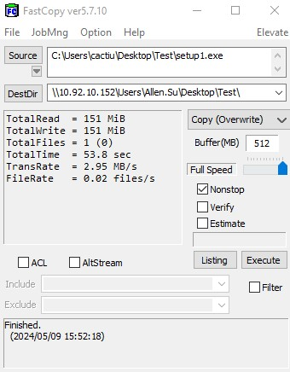
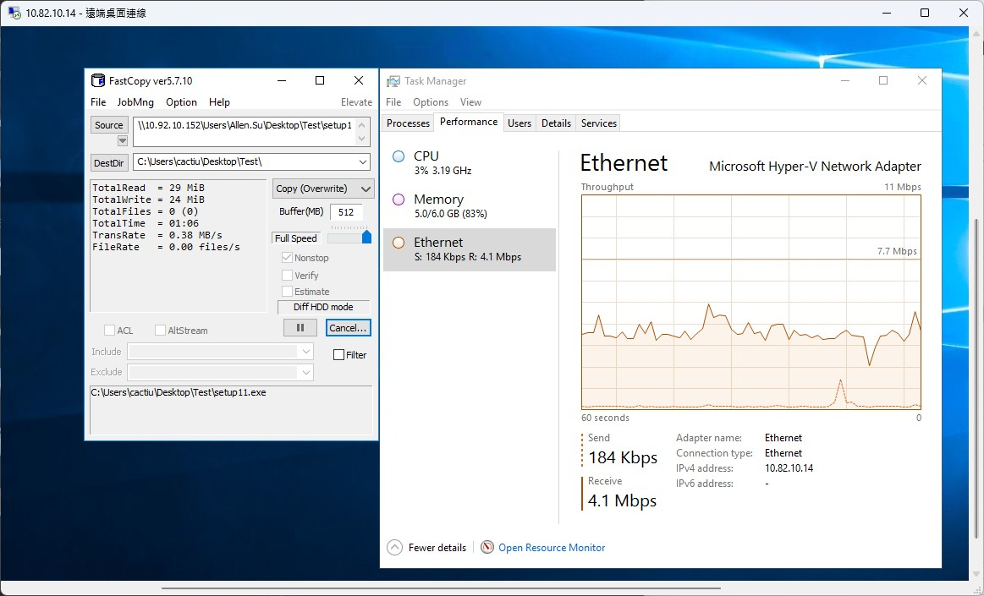
POC-測試項目 下載檔案速度
越南->台灣
台灣->越南

Slide 20
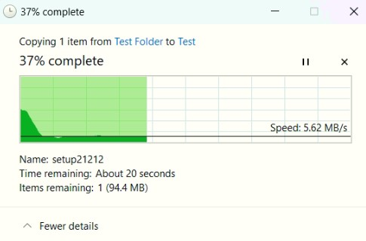
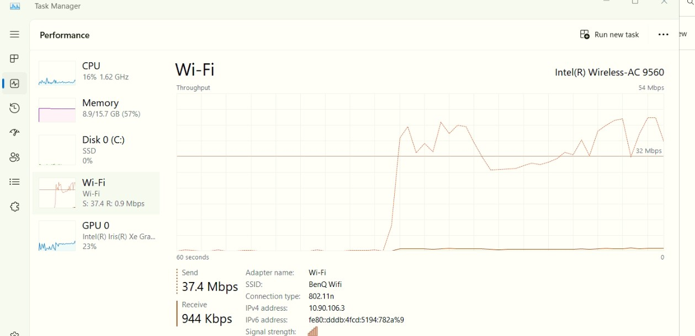
POC-測試項目 下載檔案速度
馬來西亞->台灣
台灣->馬來西亞

Slide 21
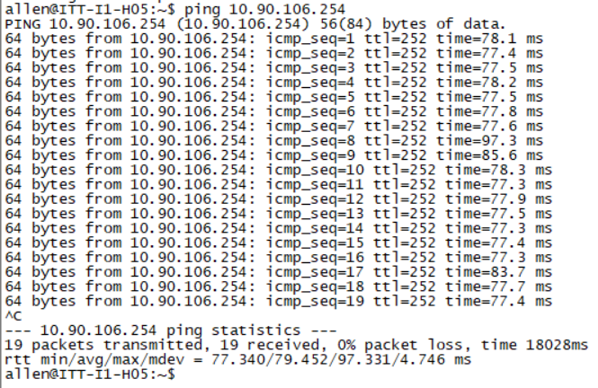
POC-測試項目 連線品質 台北->馬來西亞
使用原本VPN線路

Slide 22
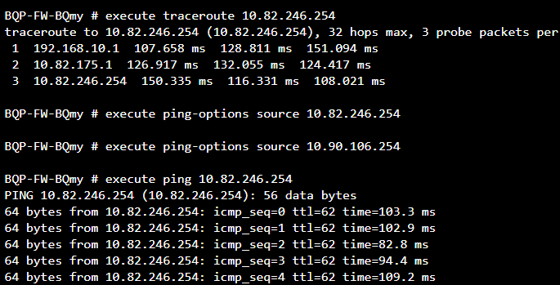
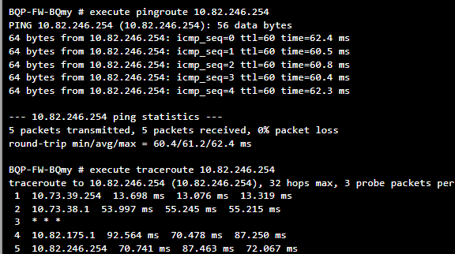
POC測試項目 連線品質 馬來西亞->Taipei
使用原本VPN線路
使用Prisma線路

Slide 23
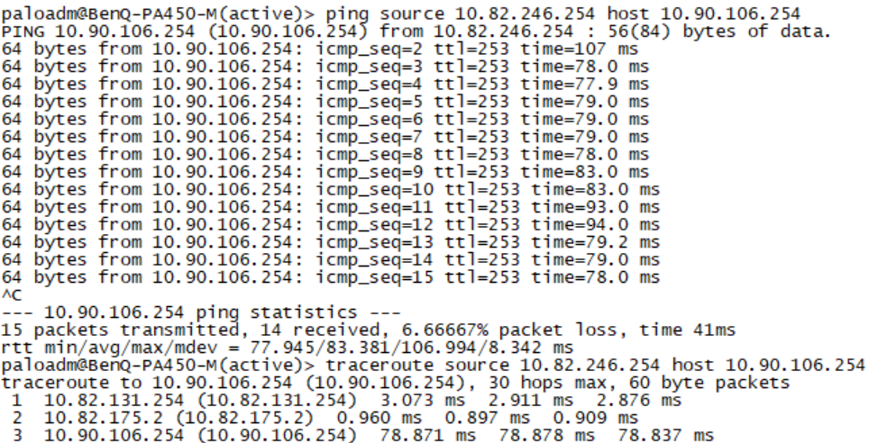
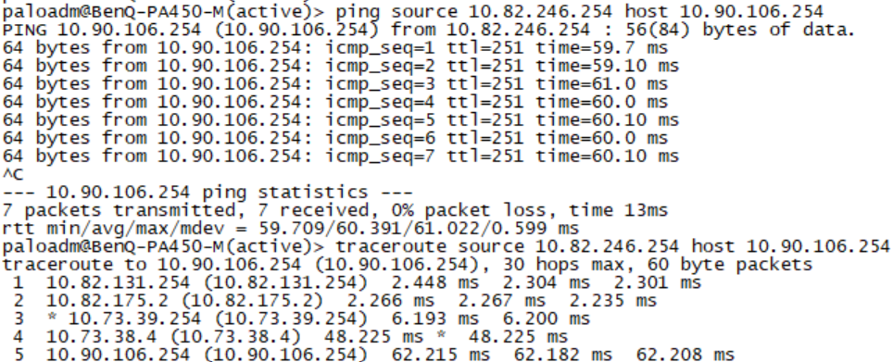
POC測試項目 連線品質 Taipei->馬來西亞
使用原本VPN線路
使用Prisma線路

Slide 24
Prisma Global Protect測試

Slide 25
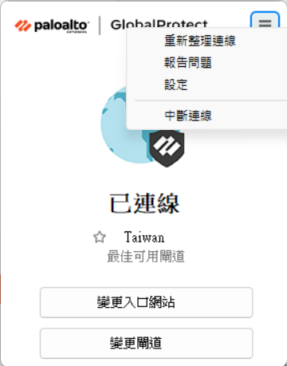
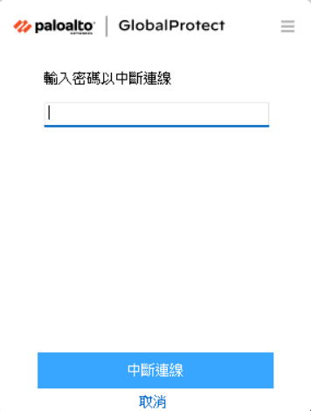
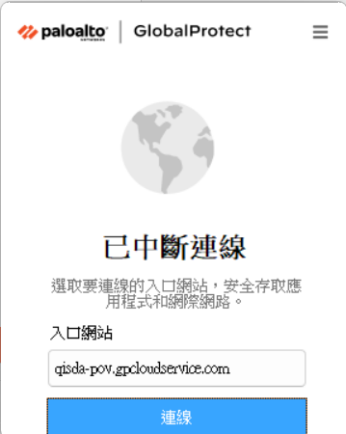
Prisma Global Protect 情境1 Always on 非有特殊密碼，不得擅自關閉GP
B1e2n3Q4

Slide 26
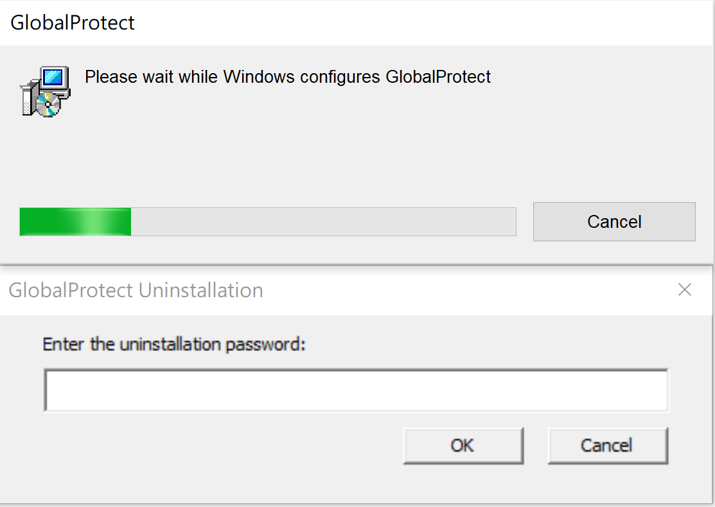
Prisma Global Protect 情境1 uninstallation password 非有特殊密碼，不得擅自移除GP
B1e2n3Q4

Slide 27
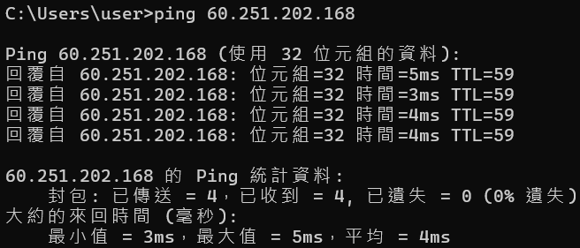
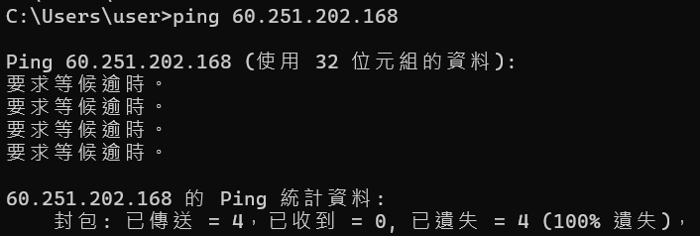
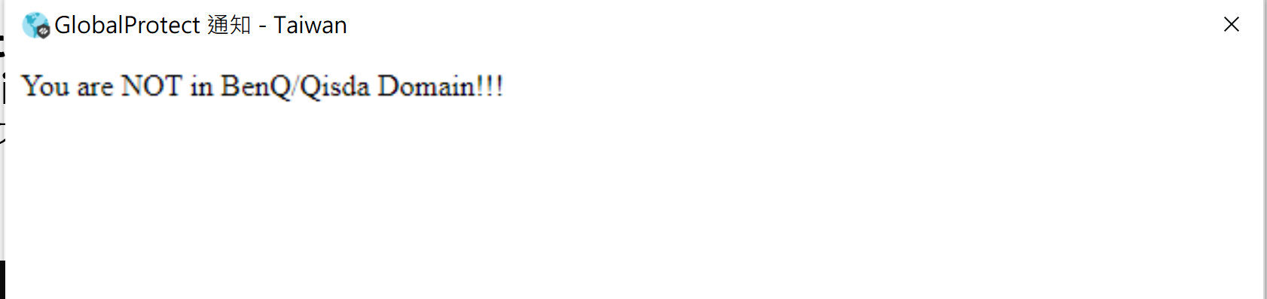
Prisma Global Protect 情境2 Domain user 可以ping 60.251.202.168 Non-Domain user 不可以ping 60.251.202.168
Domain user
Non-Domain user

Slide 28
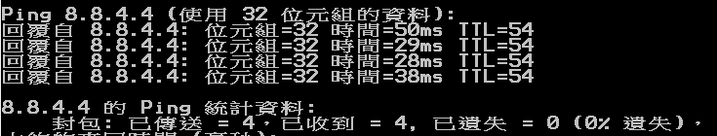
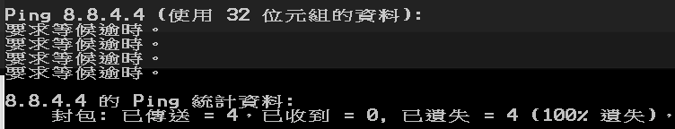
Prisma Global Protect 情境3 檢查Trendmicro是否安裝 更新碼五天內 AV Ready 可以ping 8.8.4.4 AV NOT Ready 不可以ping 8.8.4.4
TrendMicro is installed and Updated within 5 days
AV is NOT ready!

Slide 29
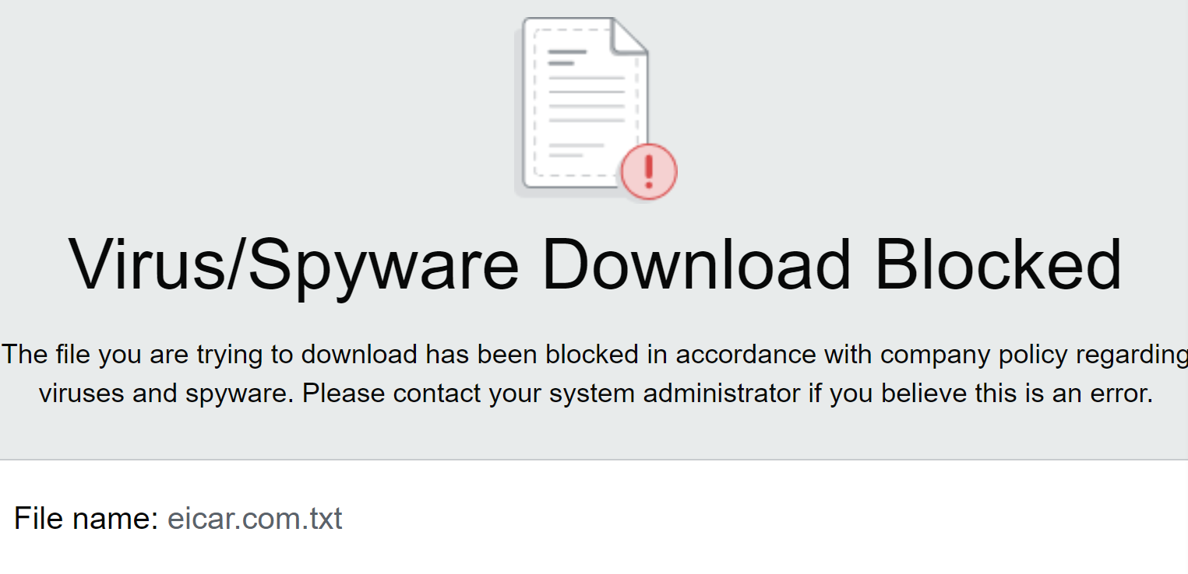
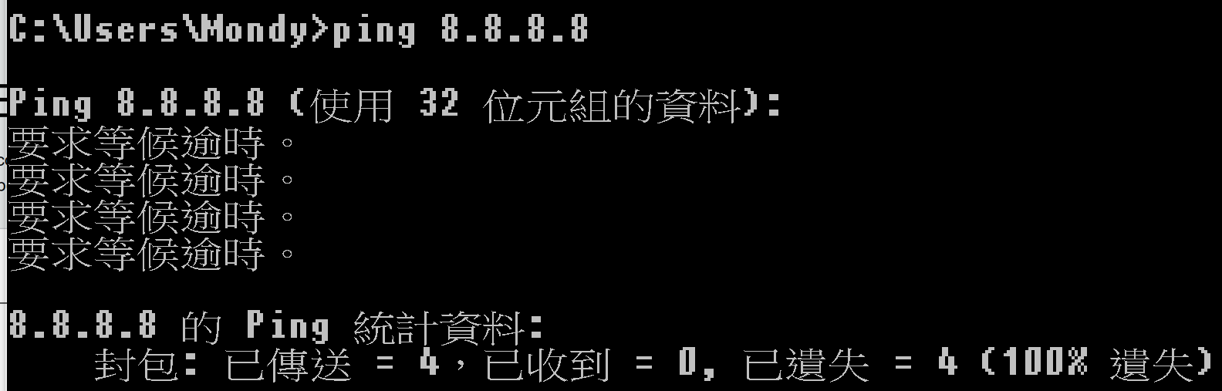
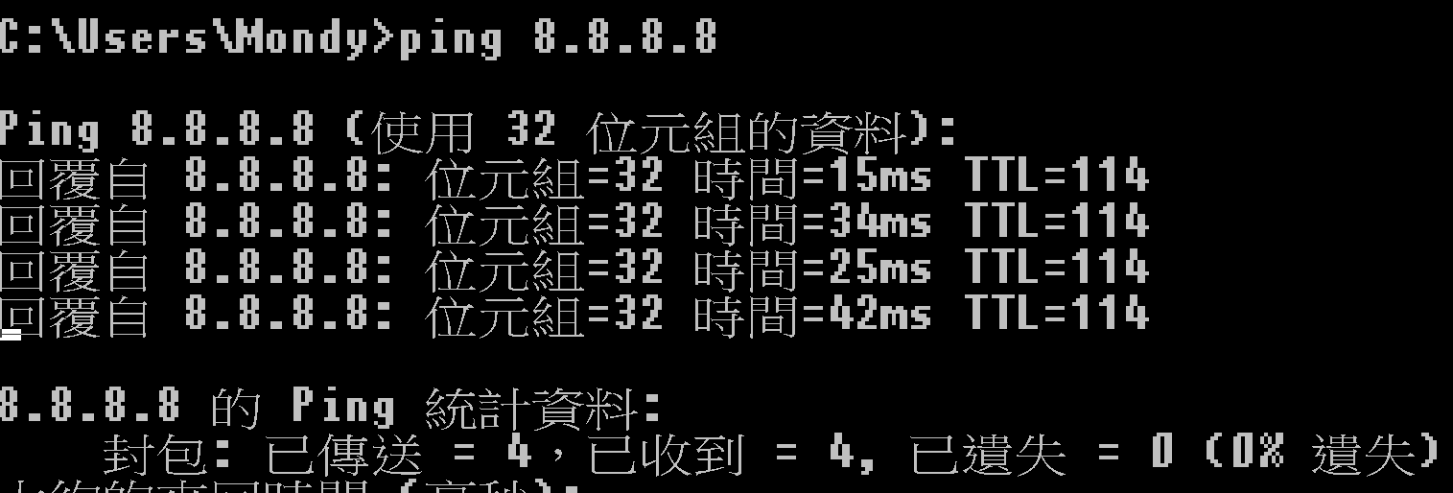
Prisma Global Protect 情境4 user 可以ping 8.8.8.8 下載virus user 不能ping 8.8.8.8 直到透過解除條件 #解除條件定義為 過1分鐘
Virus user
一分後

Slide 30
Thank you
paloaltonetworks.com

